Slide 1

Lecture 7: Machine Learning
Topics: TensorFlow Lite, Google Cloud Vision API

Slide 2
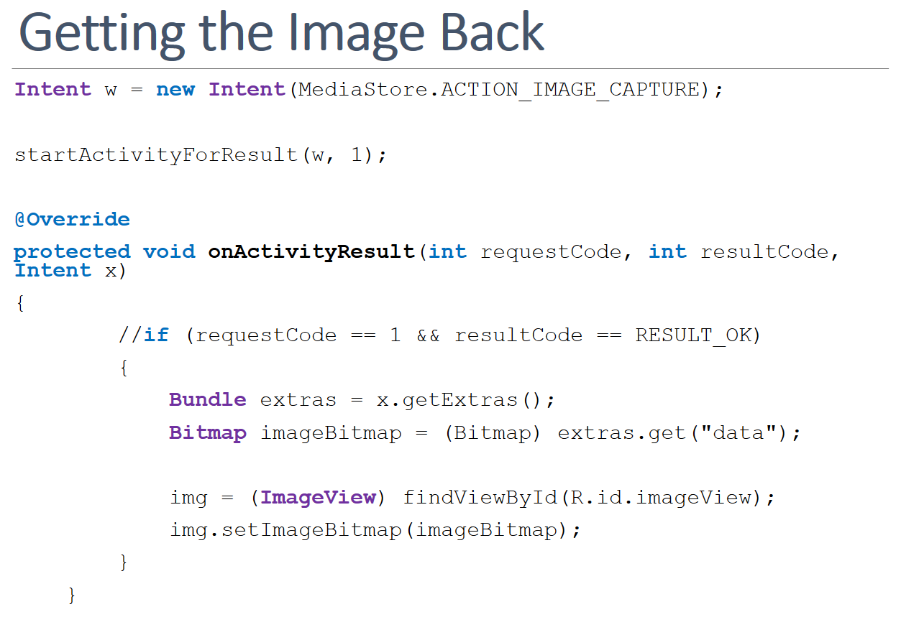
Remember Intent/Camera?
We used implicit intent to take pictures and get the image back.
We want to use AI to detect what’s in it!

Slide 3
Cloud Vision API

Slide 4
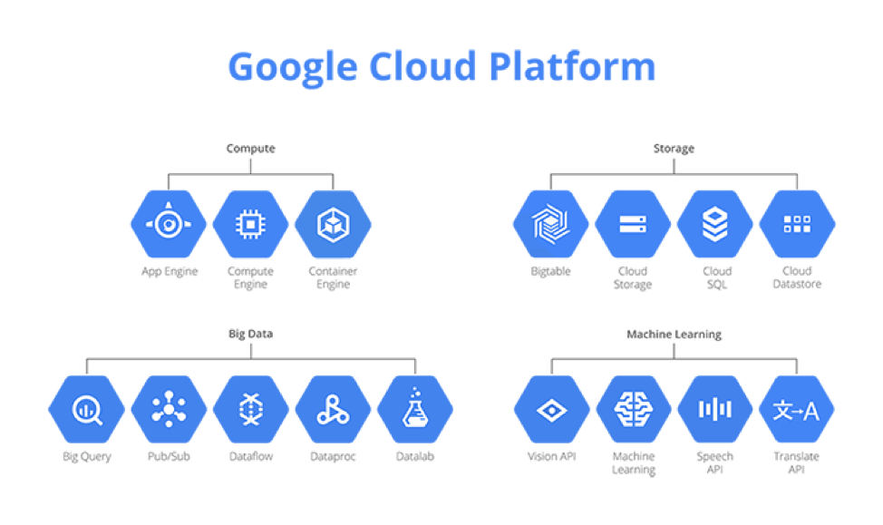
Google Cloud APIs
APIs offered by Google Cloud Platform:

Slide 5
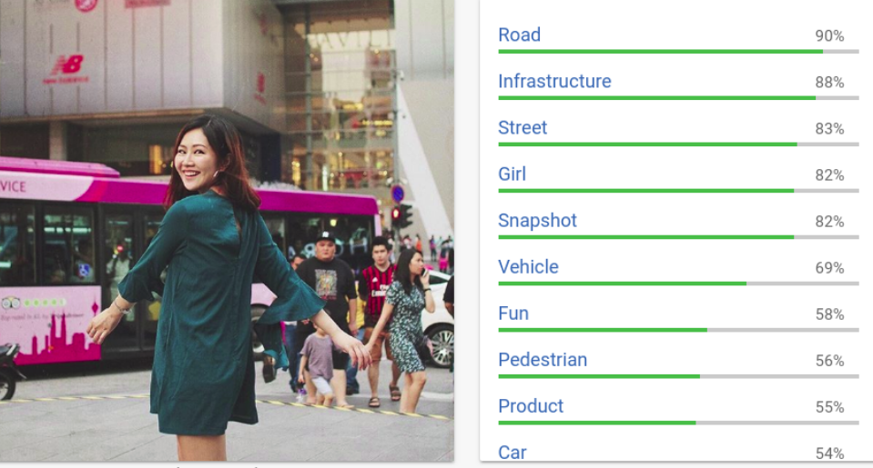
Cloud Vision APIs
APIs for – Image labeling, face, logo, landmark detection, optical character recognition, explicit content detection.

Slide 6
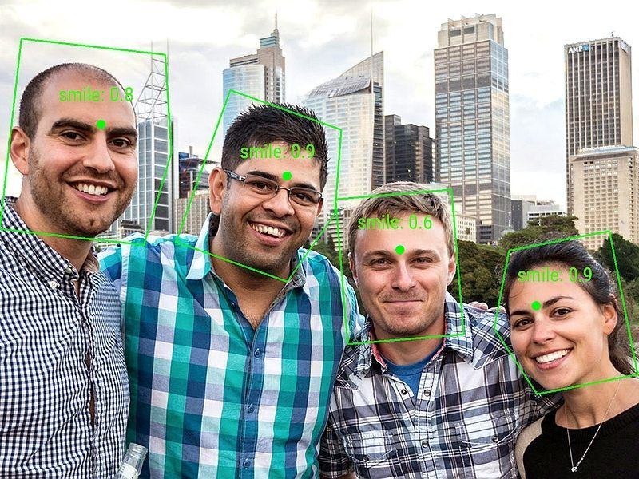
Cloud Vision APIs
APIs for – Image labeling, face, logo, landmark detection, optical character recognition, explicit content detection.

Slide 7
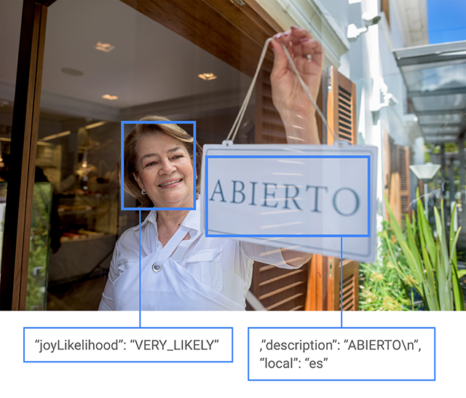
Cloud Vision APIs
APIs for – Image labeling, face, logo, landmark detection, optical character recognition, explicit content detection.

Slide 8
Using Cloud Vision API with Android
Get an API key – Create account, create credentials, create API key, enable API, copy the key.
Gradle/Permissions – Edit .gradle and manifest files.
https://cloud.google.com/apis/
build.gradle (module:app)
implementation 'com.google.api-client:google-api-client-android:1.23.0' exclude module: 'httpclient' implementation 'com.google.http-client:google-http-client-gson:1.23.0' exclude module: 'httpclient' implementation 'com.google.apis:google-api-services-vision:v1-rev369-1.23.0'
AndroidManifest.xml
<uses-permission android:name="android.permission.INTERNET" />

Slide 9
Android Code
Step 1 – ENCODE Image to Base64
Bitmap bitmap = ((BitmapDrawable)getResources()
.getDrawable(R.drawable.b1)).getBitmap();
ByteArrayOutputStream bout = new ByteArrayOutputStream(); bitmap.compress(Bitmap.CompressFormat.JPEG, 90, bout);
Image myimage = new Image(); myimage.encodeContent(bout.toByteArray());

Slide 10
Android Code
Step 2 – PREPARE AnnotateImageRequest
AnnotateImageRequest annotateImageRequest = new AnnotateImageRequest(); annotateImageRequest.setImage(myimage);
Feature f = new Feature(); f.setType("LABEL_DETECTION"); f.setMaxResults(5); List<Feature> lf = new ArrayList<Feature>(); lf.add(f);
annotateImageRequest.setFeatures(lf);

Slide 11
Android Code
Step 3 – BUILD Vision
HttpTransport httpTransport = AndroidHttp.newCompatibleTransport(); GsonFactory jsonFactory = GsonFactory.getDefaultInstance();
Vision.Builder builder = new Vision.Builder(httpTransport, jsonFactory, null); builder.setVisionRequestInitializer(new VisionRequestInitializer(“YOUR_KEY"));
Vision vision = builder.build();

Slide 12
Android Code
Step 4 – CALL Vision.Images.Annotate
BatchAnnotateImagesRequest request = new BatchAnnotateImagesRequest(); List<AnnotateImageRequest> list = new ArrayList<AnnotateImageRequest>(); list.add(annotateImageRequest); request.setRequests(list);
Vision.Images.Annotate task = vision.images().annotate(request); BatchAnnotateImagesResponse response = task.execute();
Log.v("MYTAG", response.toPrettyString());

Slide 13
Code Practice
Study GoogleCloudVision_LabelDetection in the GitHub and modify it to integrate camera images.
https://github.com/uncmobile/GoogleCouldVision_LabelDetection

Slide 14
TensorFlow Lite

Slide 15
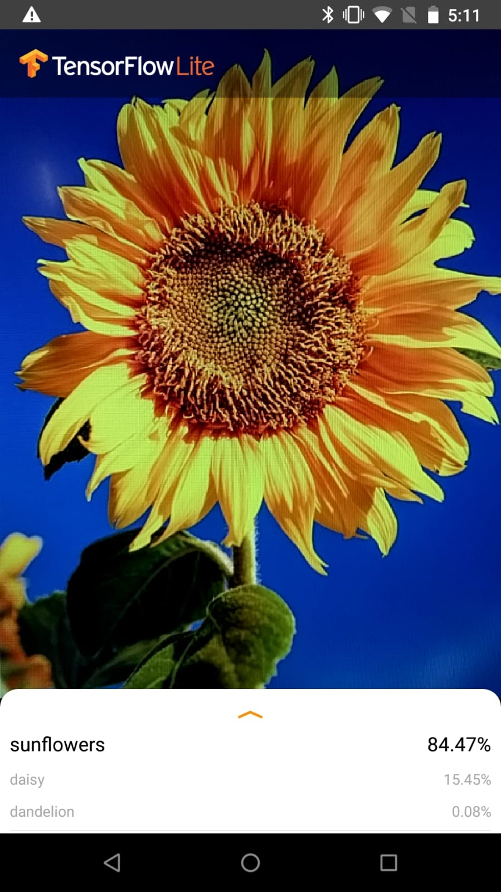
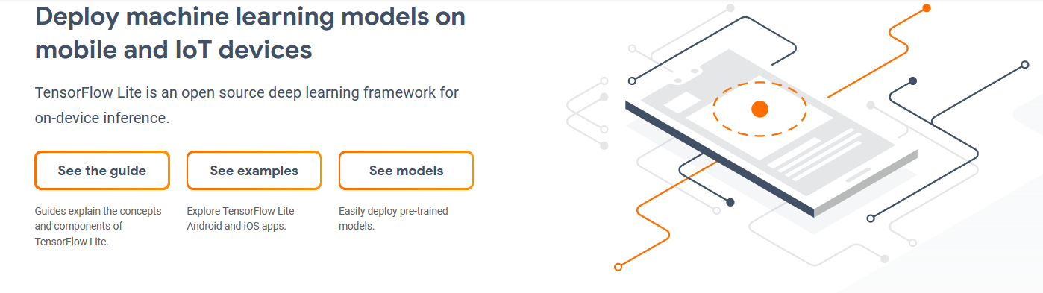
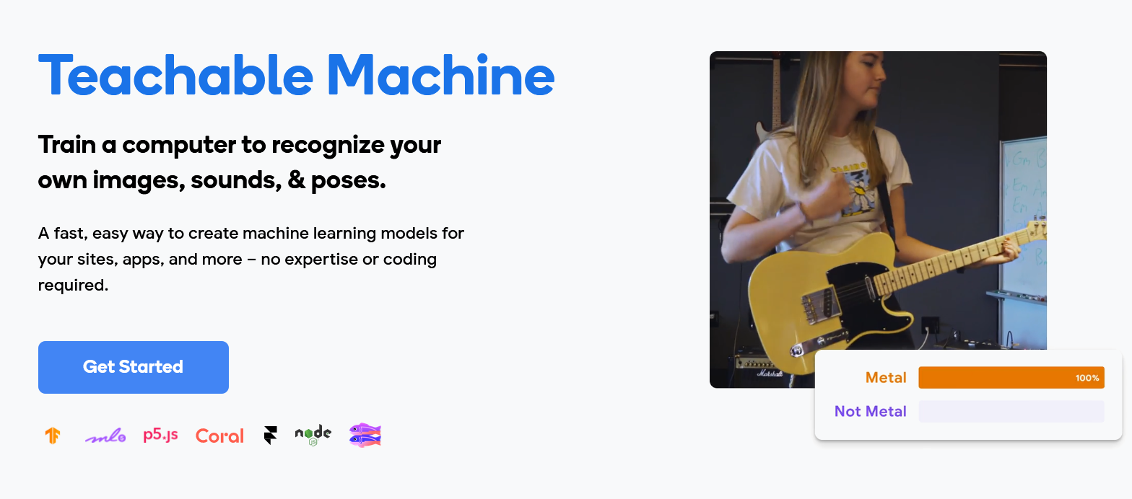
TensorFlow Lite
Use a pre-trained model or train one.

Slide 16
Using TF Lite in Android
Get a pre-trained model – Download and copy (model and labels files) into the “app/assets” folder.
Gradle – edit build.gradle (module:app)
https://www.tensorflow.org/lite/models
dependencies { implementation('org.tensorflow:tensorflow-lite:0.0.0-nightly') { changing = true } implementation('org.tensorflow:tensorflow-lite-gpu:0.0.0-nightly') { changing = true } implementation('org.tensorflow:tensorflow-lite-support:0.0.0-nightly') { changing = true } }
android { aaptOptions { noCompress "tflite" noCompress "lite" } }

Slide 17
Android Code
Step 1 – Prepare the model “Interpreter”
AssetFileDescriptor afd = getAssets().openFd("mobilenet_v1_1.0_224_quant.tflite");
FileInputStream fis = new FileInputStream(afd.getFileDescriptor());
FileChannel fc = fis.getChannel();
MappedByteBuffer mbb = fc.map(FileChannel.MapMode.READ_ONLY, afd.getStartOffset(), afd.getLength());
Interpreter interpreter = new Interpreter(mbb);

Slide 18
Android Code
Step 2 – Prepare Input and Output
Step 3 – Run the Interpreter
//We copied a 224x224 png image into the resource folder.
Drawable drawable = getResources().getDrawable(R.drawable.lizard224); Bitmap bitmap = ((BitmapDrawable)drawable).getBitmap(); //224x224 (32 bit) TensorImage tensorImage = TensorImage.fromBitmap(bitmap);
TensorBuffer result = TensorBuffer.createFixedSize(interpreter.getOutputTensor(0).shape(), interpreter.getOutputTensor(0).dataType());
interpreter.run(tensorImage.getBuffer(), result.getBuffer().rewind());
//result contains 1x1001 byte array of probabilities (one for each class).
//use the labels file in the resource folder containing the text labels.

Slide 19
References
https://github.com/tensorflow/examples/tree/master/lite/examples/image_classification/android
https://cloud.google.com/
https://cloud.google.com/apis/docs/overview
https://cloud.google.com/vision/overview/docs/
https://cloud.google.com/vision/docs/samples

